Slide 1
Nail Salon Management System
Deliverable 3/4: Design Phase
Salman Khan, Hamza Mir, Thomas Zhang, Spencer Wilkins, Derek Luong, Asad Khan
https://github.com/tzhang490/IS-436.git

Slide 2
Project Recap
Refined the scope and design of the project.
Changed to only be an app to schedule appointments, track customers, and customer loyalty program.
Narrower, but more in depth.
Still planning on designing an App for the customers to use and an interface for employees to access. Depending on login credentials different access would be given.

Slide 3
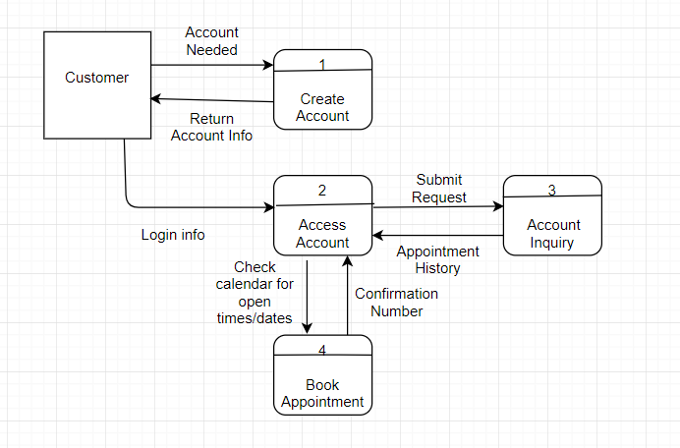
Level 0 diagram
Notes:
Processes
Create Account - Process will create a user account for the customer if one has not yet yet been created for them.
Access Account - Process will allow user to login to created account
Account Inquiry - Process will allow customer to request and receive information about their account
Book Appointment - Process will allow customer to look at company calendar and book an appointment date that is open.

Slide 4
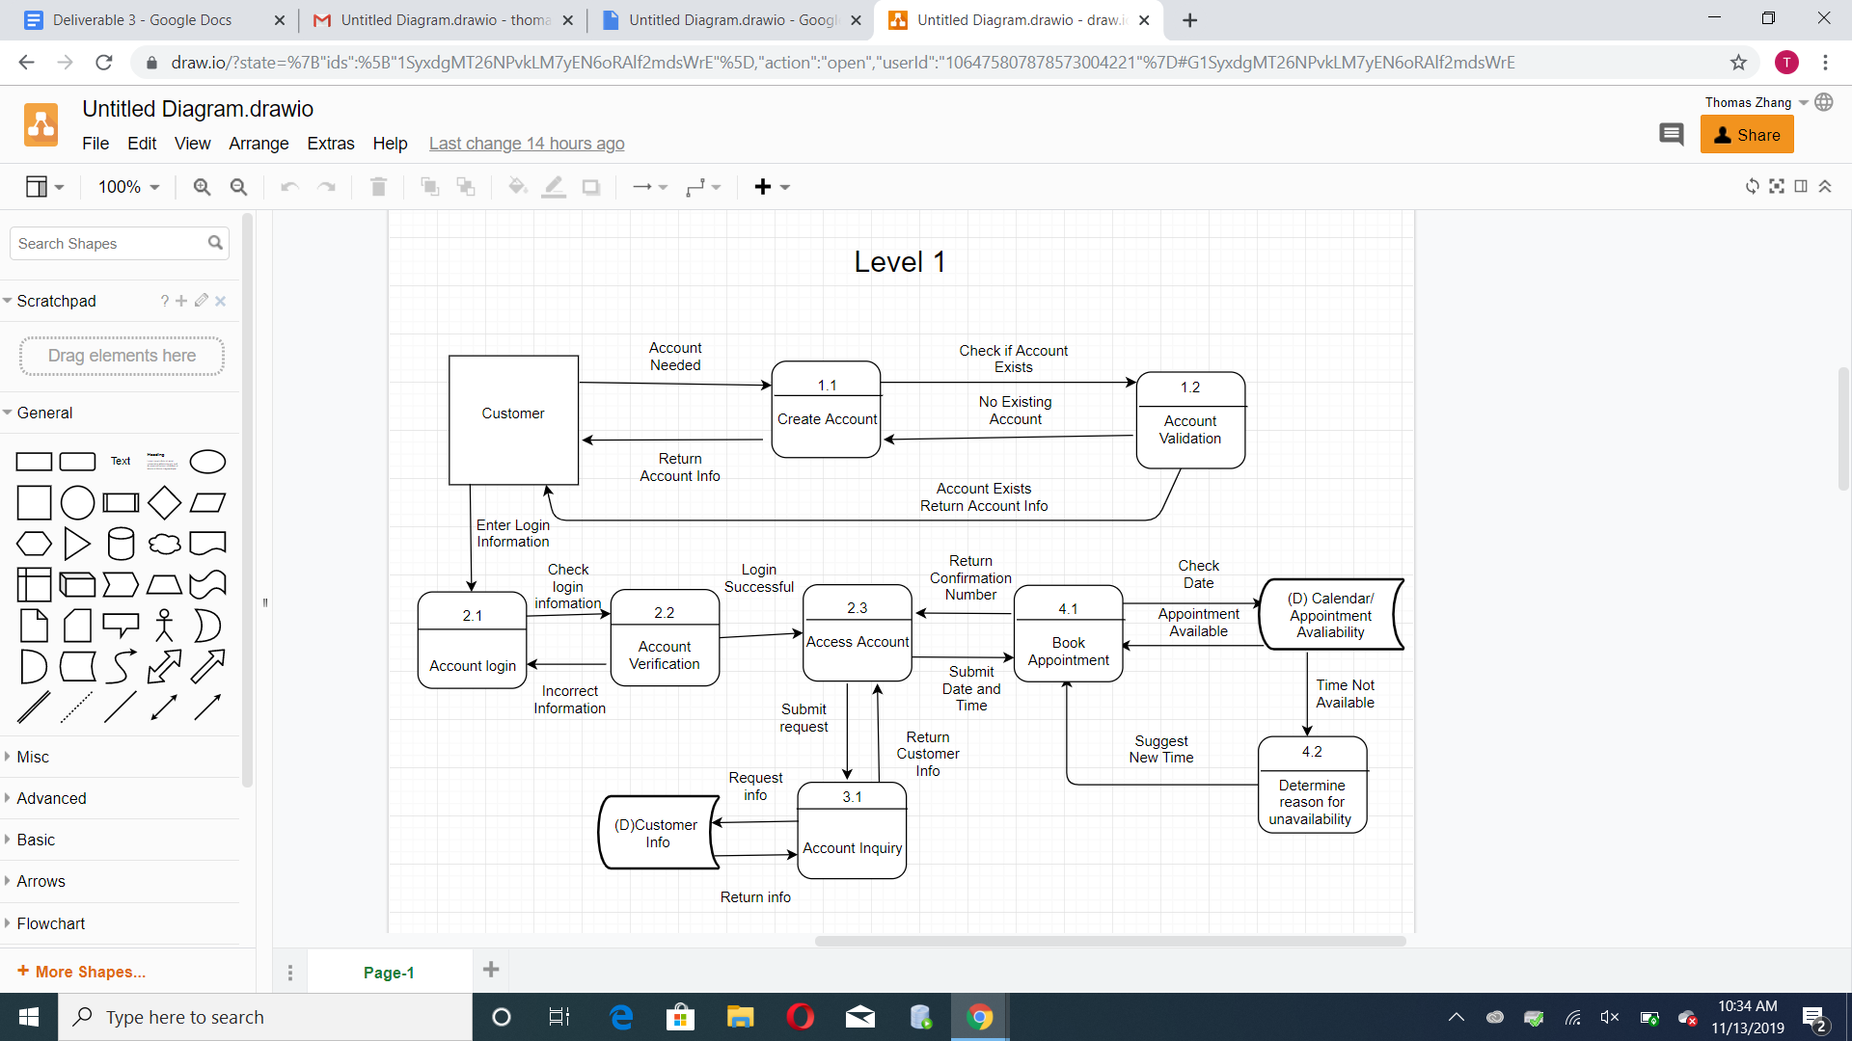
Level 1: Diagram

Slide 5

Level 1- Process: Create Account
Notes:
Processes
Create Account - Same as Level 0
Account Validation - System will check if user is creating an account that already exists via email
Dataflow
Account Needed - customer requests the need for account creation
Return Account Info - customer creates account and the system will send the customer a notification that the account has been created
Check if account exists - User will submit account information to the system and the system will check if a previous account exists.
No existing account - If no account exists then new account will be created with customer information that was given
Account exists return account info - If account exists then customer will be asked to input existing account info

Slide 6
Level 1- Process: Accessing Account
Notes:
Processes
Account Login - Customer will use login information to login to account
Account Verification - Customer login information will be verified for correctness
Access Account - Same as Level 0
Data Flow
Enter Login Info - Customer will enter account login information
Check Login Info - Login information will be checked for correctness
Incorrect Info - The login information inputted was not correct and an error message will be sent to user
Login Successful - The login information was correct and the user will be able to access account

Slide 7
Level 1- Process: Account Inquiry
Notes:
Processes
Account Inquiry - Process will allow customer to request and receive information about their account
Customer Info - System will find and retrieve customer information from database
Dataflow
Submit Request - User submits request to access account inquiry
Return Customer Info - Customer information is returned
Request Info - System receives customer request to access information
Return Info - System retrieves customer information

Slide 8
Updates to Requirement Documentation and Use Cases
Simplified project, removed reward system/ point tracking from transaction purchases and transaction tracking from process design
Emphasized account creation and appointment scheduling ability on process section.
Updated information design specifying customer ability to view appointment and account information
Remove reward system use case
Fixed and updated minor errors on remaining use cases

Slide 9
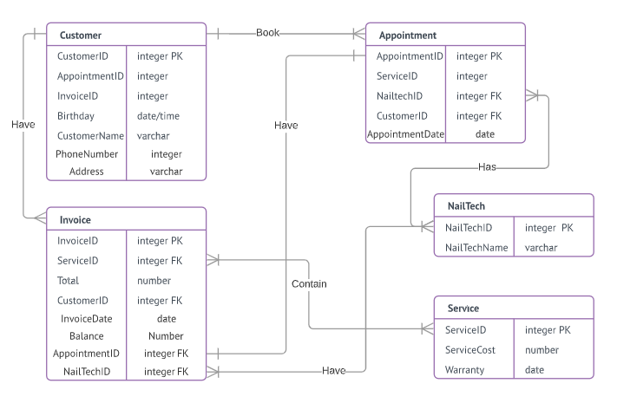
ER Diagram

Slide 10
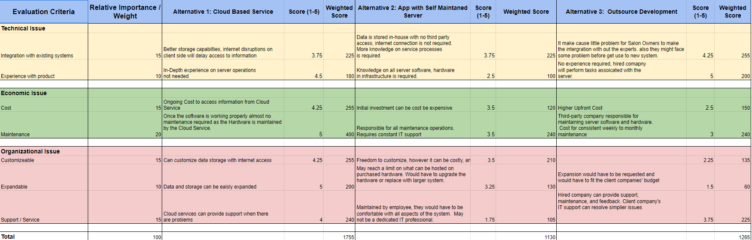
Alternative Matrix
Alternative 1(Cloud Based): 1765 Alternative 3 (Outsource): 1265
Alternative 2(Self Maintained): 1130
Notes:
Alternative 1 was selected as the best choice due to its combination of easier maintainability, cheaper cost, easier expandability and customization and better storage capabilities. This choice best fit with our business that requires massive customer data storage and constant data flow. Although alternative 3 had comparable integration and maintainability requirements, requesting expansion and customizations as well as having a large upfront cost makes it a worse option. Alternative 2 was the worst rated option due to its difficult implementation and extensive knowledge required in IT server hardware and software. It would have high maintenance, customization, expansion and initial cost compared to alternative 1 and had a unique issue in that storage space would be required to house the servers. It does have the benefit of not requiring internet connections and not worrying about any third parties but the benefits do not outweigh the disadvantages.

Slide 11
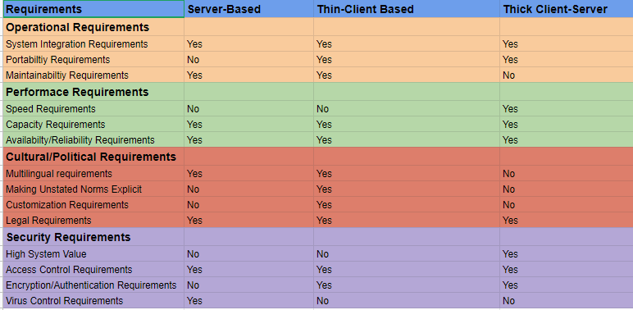
Requirements Matrix

Slide 12
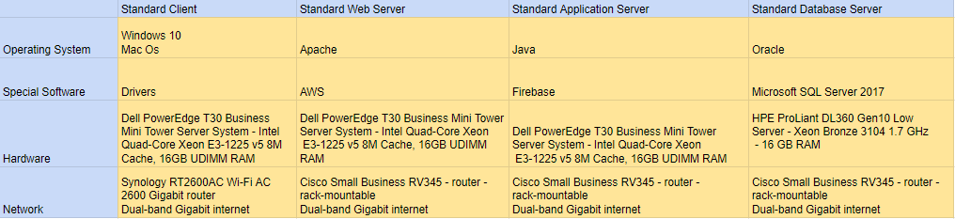
Hardware/Software Specifications

Slide 13
System Integration
Customer database information will be shared using third party cloud server with Paradise Pizza’s Restaurant.
The account created can be used in both services.
Using third party service will lessen security risks

Slide 14
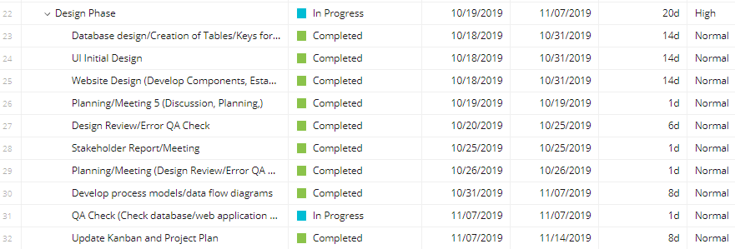
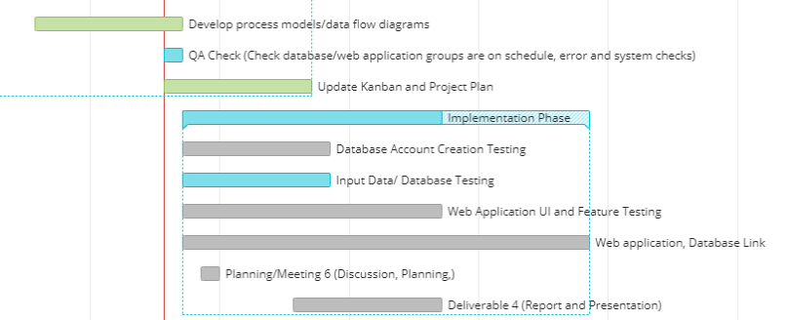
Project
Plan: 3+4

Slide 15
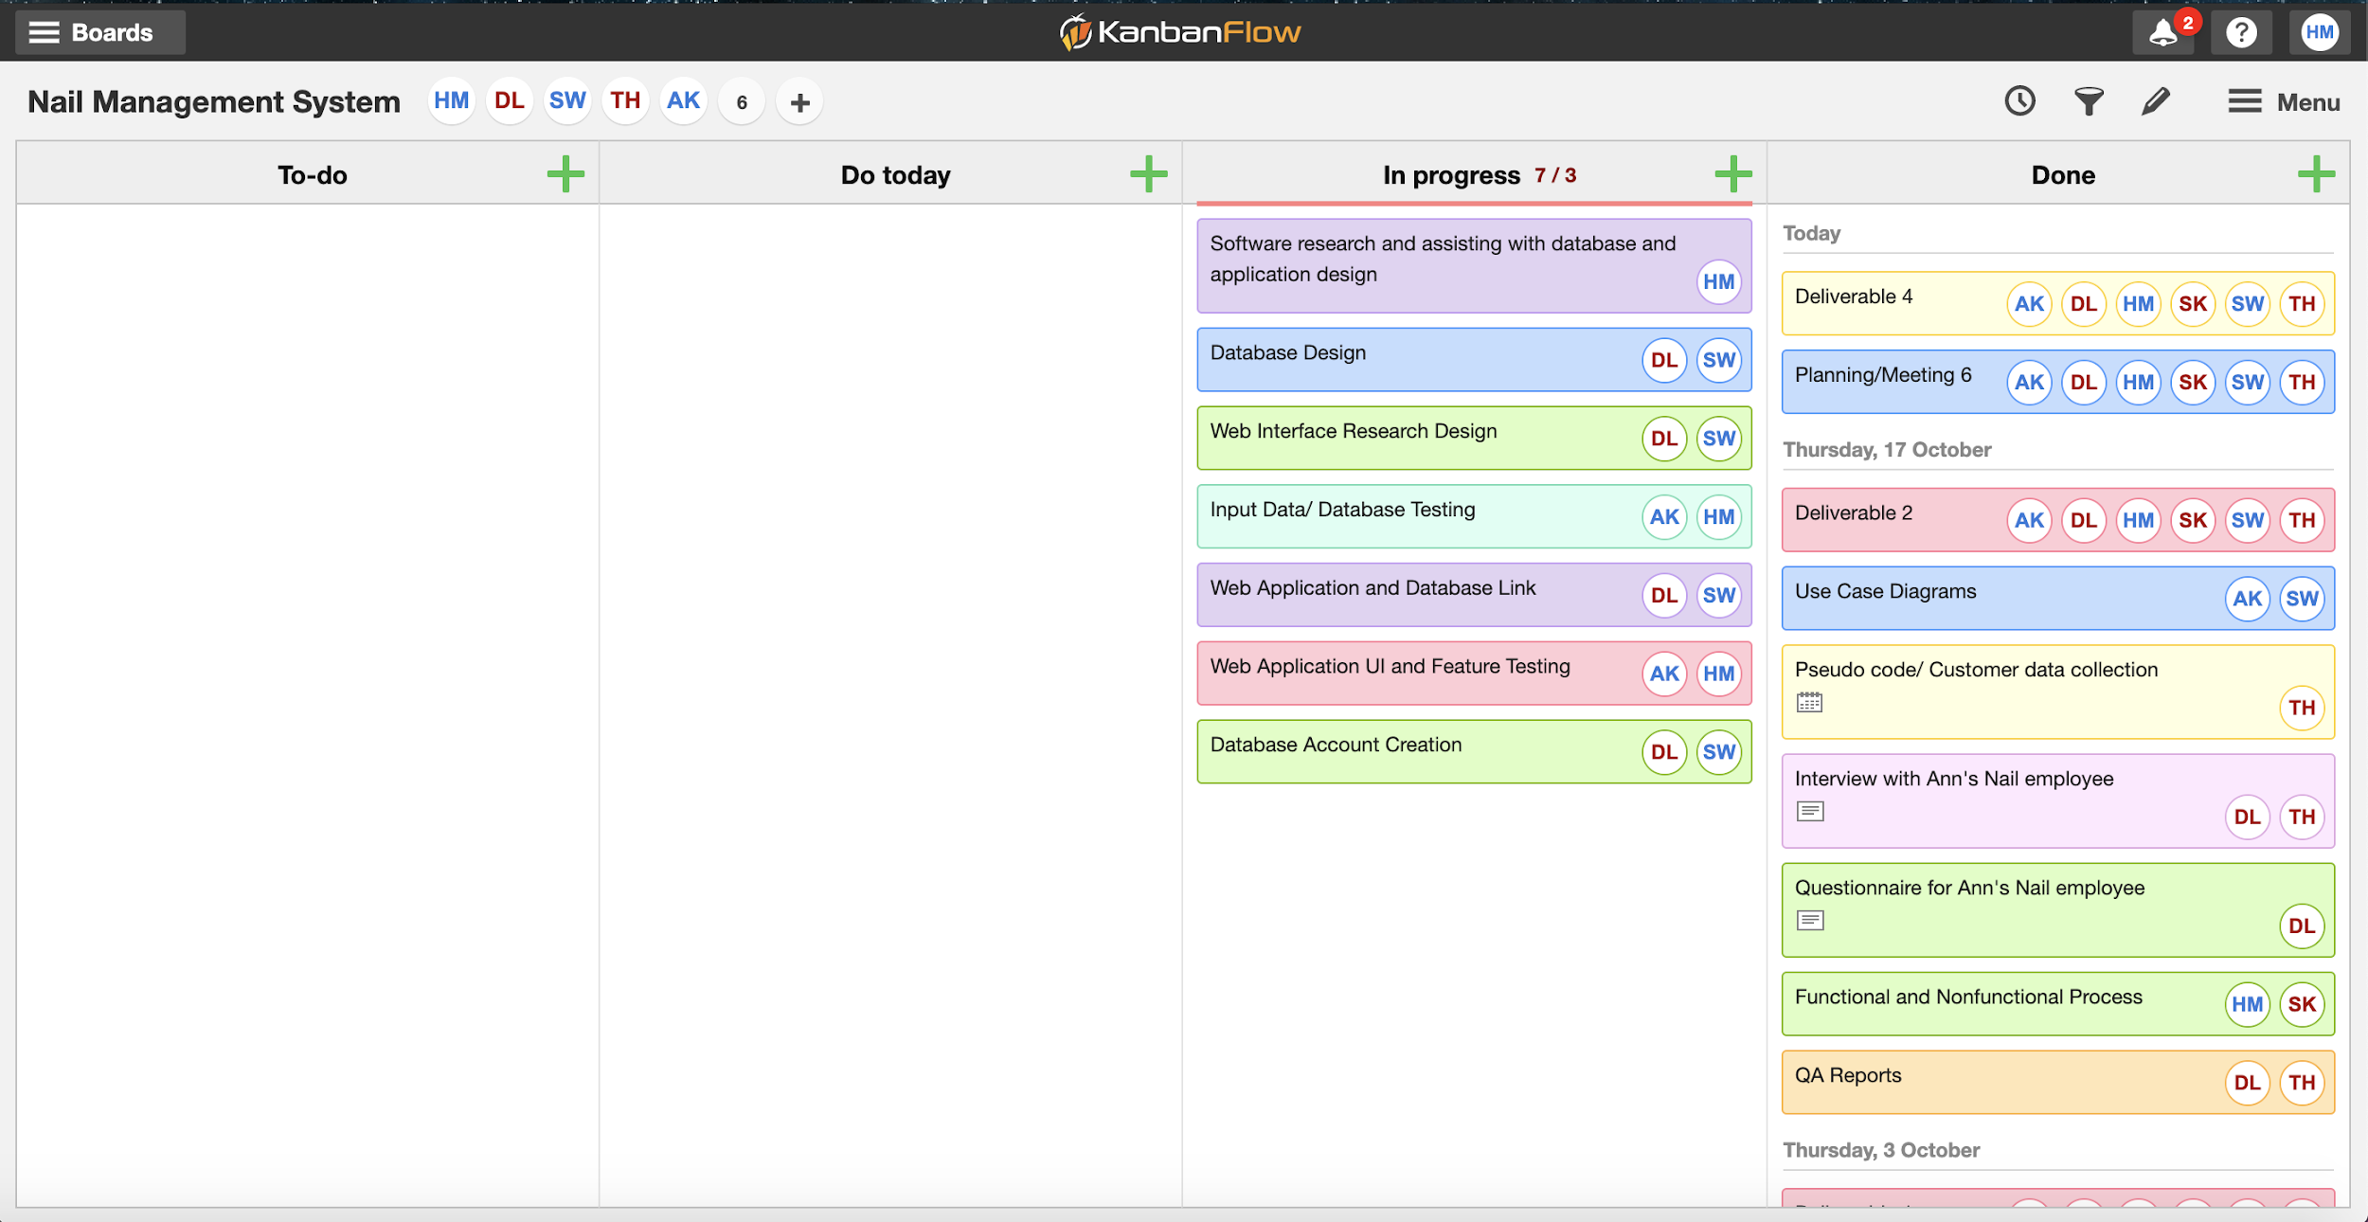
Kanban: Deliverable 3

Slide 16
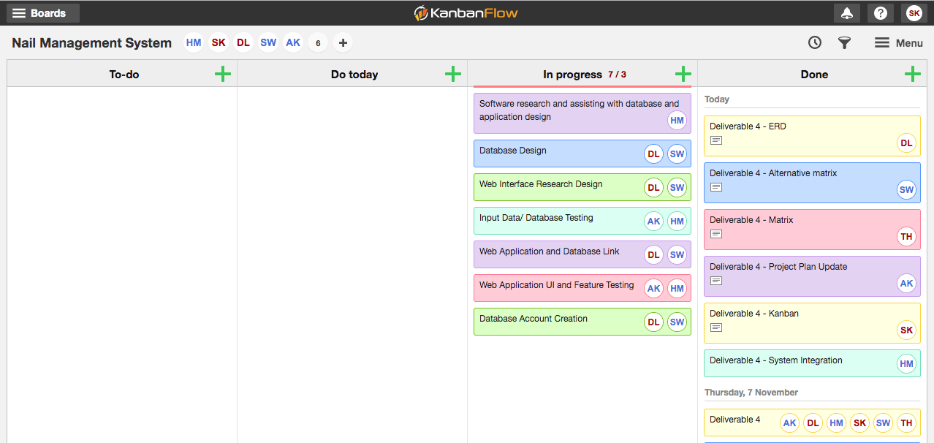
Kanban: Deliverable 4

